Slide 1





ISCG8050 Machine Learning for Intelligent Data and Information Processing
Week1 - B
Sources: Hands-On Machine Learning with Scikit-Learn, Keras, and TensorFlow by Aurélien Géron
https://pub.towardsai.net/machine-learning-algorithms-for-beginners-with-python-code-examples-ml-19c6afd60daa

Slide 2
Spot Quiz
Identify the type of machine learning models we can use to solve these problems:
A. Supervised Classification / B. Supervised Regression / C. Unsupervised / D. Reinforcement Learning.
Analysing images of products on a production line to automatically classify them
Detecting tumours in brain scans
Automatically classifying news articles
Forecasting your company’s revenue next year, based on many performance metrics
Making your app react to voice commands
Detecting credit card fraud
Up-sampling images and videos
Building an intelligent bot for a game
Representing a complex, high-dimensional dataset in a clear and insightful diagram

Slide 3
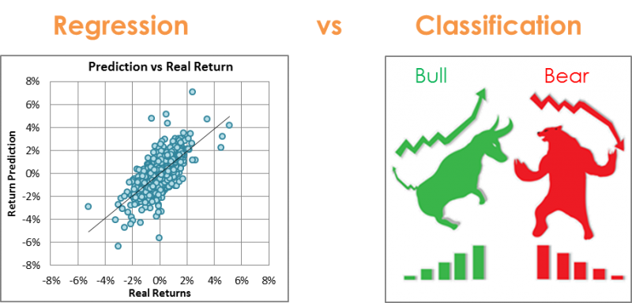
An Example of Supervised Learning
Known
Normal
Emails
…
…
…
Spam
…
…
…
…
New emails
Learner …
Unknown
Spam
Normal emails

Slide 4
Outlines
Terminology
Predictive Models
Creating Models
First Test explanation and release
First Assignment explanation and release

Slide 5
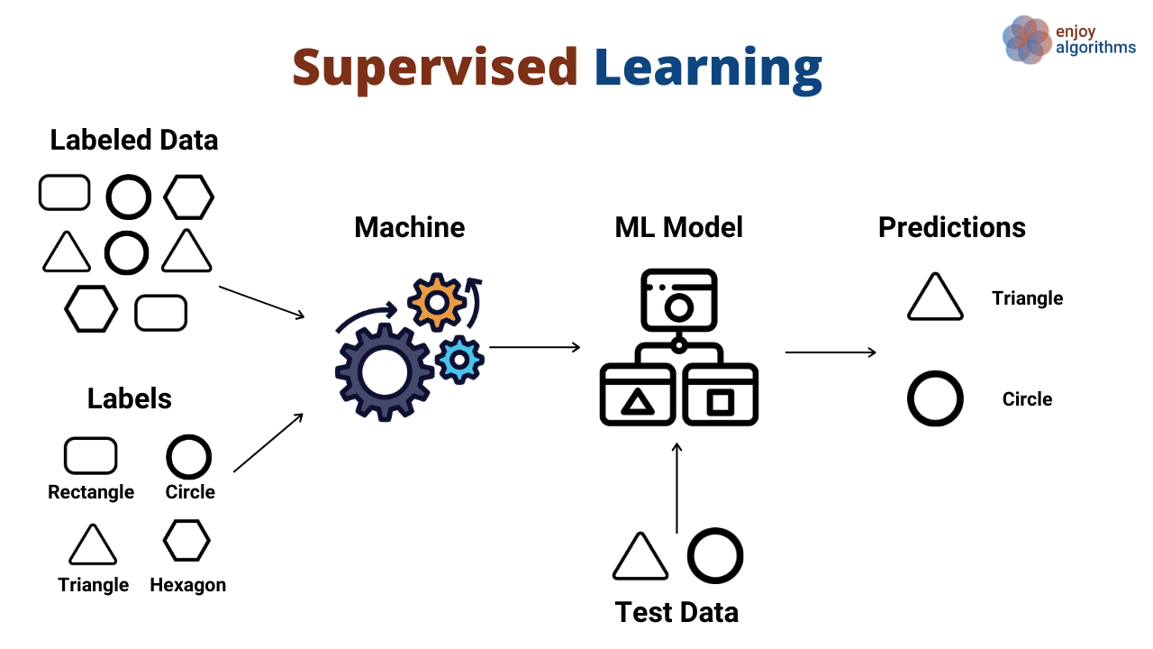
A Supervised Model
Prediction
Target (Expected Outcome)
Cost Function: Prediction vs Target

Slide 6
Terminology
Features
Also known as attributes, independent variables, input,…
Target
Also known as goal predicate, dependent variable, output,…
Hypothesis
Also known as discrimination, classification/regression,…
Cost function
Also known as objective function, loss function, error function,…
Training Set
Learning Algorithm
Size of house
h
Estimated price

Slide 7
Terminology Feature
A feature is a measurable property of the object you’re trying to analyse.
In datasets, features appear as columns.
Each feature represents a measurable piece of data that can be used for analysis: Name, Age, Sex, Fare, …
Features are also sometimes referred to as “variables” or “attributes.”
Features act as the input in the model
The quality of the features in your dataset has a major impact on the quality of the insights you will gain when you use that dataset for machine learning.

Slide 8
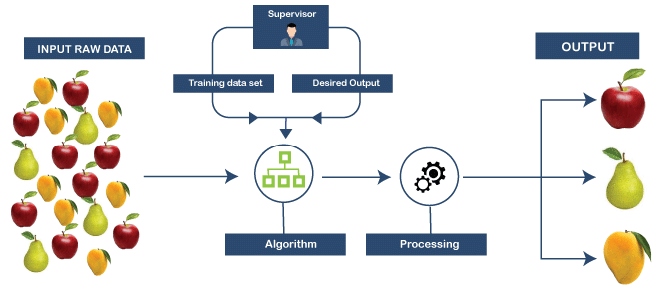
Terminology Target
The target is the output of the input variables.
It is the final output we are trying to predict or achieve.
Label vs Target?
They are often used interchangeably.
Label is the tag we assign to our data in supervised learning models
Target is the output the model expects or predicts
https://www.tutorialandexample.com/supervised-machine-learning/

Slide 9
Terminology Cost Function
‘Cost’ or ‘Loss’ in Machine learning helps us understand the difference between the predicted value & the actual value.
The cost function returns the error between predicted outcomes compared with the actual outcomes.
The aim of supervised machine learning is to minimize the overall cost.
There are many cost functions in machine learning and each has its use cases depending on whether it is a regression problem or classification problem.
Regression cost Function
Binary Classification cost Functions
Multi-class Classification cost Functions

Slide 10
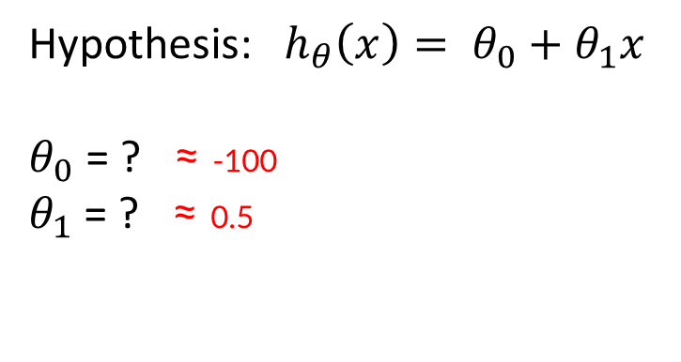
Terminology Hypothesis
In most supervised machine learning algorithm, our main goal is to find out a possible hypothesis that could approximately find a mapping from the inputs to the proper outputs.
A hypothesis is a function that best describes the target in supervised machine learning.
Hypothesis: $h_{θ}\left(x\right)= θ_{0}+θ_{1}x$
$θ_{0}$ = ? ≈ -100
$θ_{1}$ = ? ≈ 0.5
Price
(in 1000s of dollars)
Size (feet²)

Slide 11
A Supervised Model
Hypothesis
Prediction
Target (Expected Outcome)
Cost Function: Prediction vs Target

Slide 12
Predictive Models
Linear Regression
Simple Linear Regression
Multivariable Linear Regression
Polynomial Regression
Exponential Regression
Logistic Regression
Logarithmic Regression

Slide 13

Predictive Models Linear Regression
Linear regression is a statistical approach that models the relationship between input features and output.
Fit a line to a data set of observations
Use this line to predict the unobserved data
Predicts points
The input features are called the independent variables
The output is called a dependent variable
Hypothesis: $h_{θ}\left(x\right)= θ_{0}+θ_{1}x$ or $θ_{0}+θ_{1}x+θ_{2}x^{2}$
Or …
Price ($)
in 1000’s
Size in feet²
Housing Price Prediction Example

Slide 14
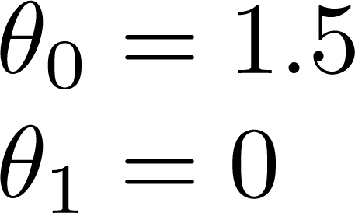
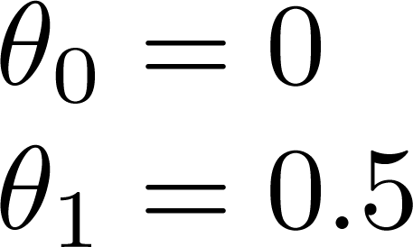
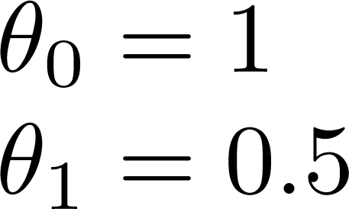
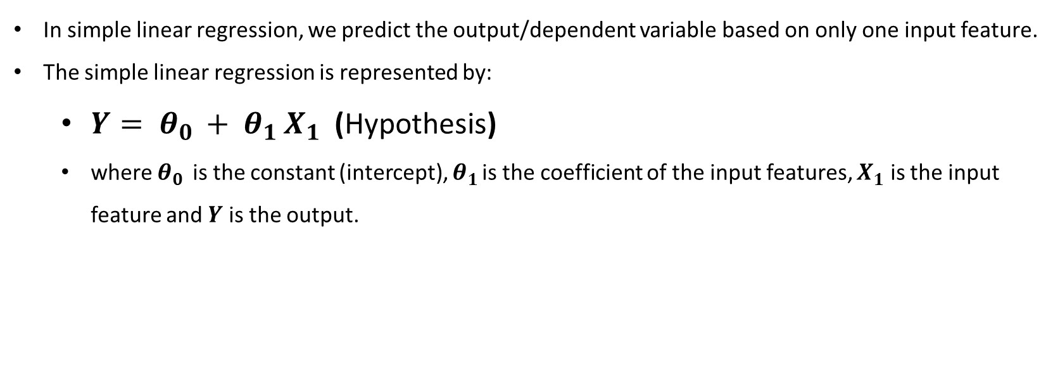
Predictive Models Simple Linear Regression
In simple linear regression, we predict the output/dependent variable based on only one input feature.
The simple linear regression is represented by:
$Y= θ_{0 }+ θ_{1 }X_{1}$ (Hypothesis)
where $θ_{0 }$ is the constant (intercept), $θ_{1 }$is the coefficient of the input features, $X_{1}$ is the input feature and $Y$ is the output.

Slide 15
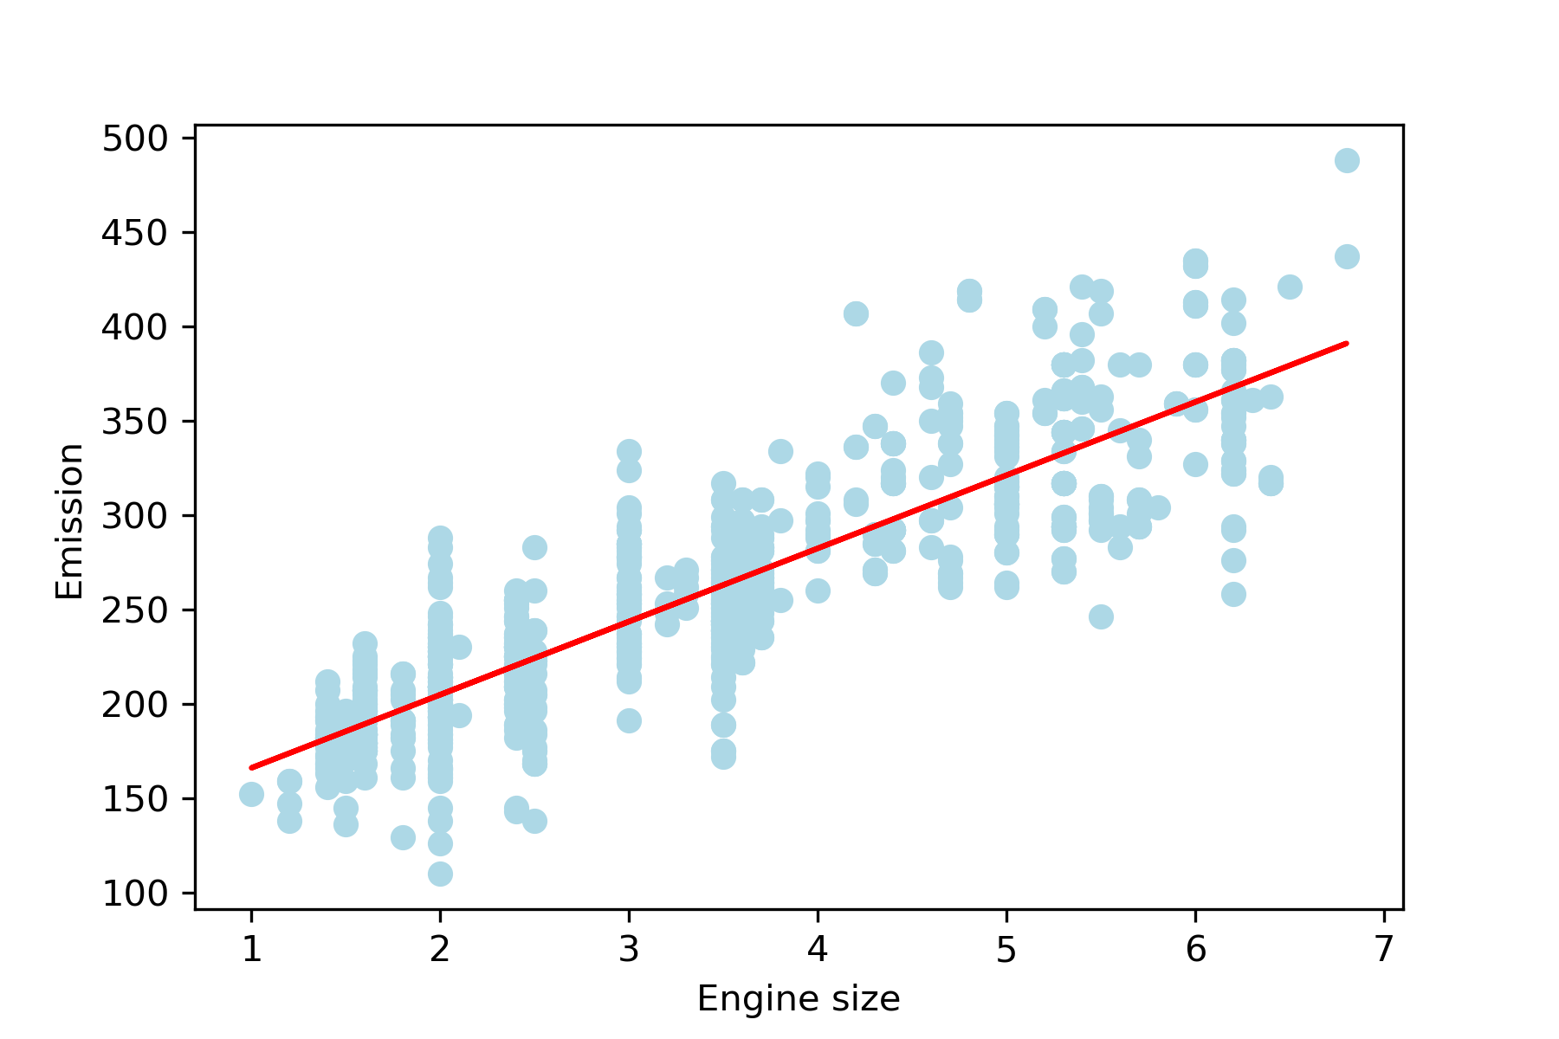
Predictive Models Simple Linear Regression
Open the Jupyter Notebbok
Now we will implement a simple linear regression model to predict the cars’ CO2 emission based on their engine size

Slide 16
Predictive Models Simple Linear Regression
Import the necessary libraries
Read the “FuelConsumptionCo2.CSV” file. It is uploaded in the model.
Plot the data. The goal is to predict the value of “co2 emissions” from the value of “engine size” in the dataset.
import pandas as pd
import numpy as np
import matplotlib.pyplot as plt
from sklearn import linear_model
data = pd.read_csv('FuelConsumptionCo2.csv')
data.head()
plt.scatter(data['ENGINESIZE'] , data['CO2EMISSIONS'] , color='lightblue')
plt.xlabel('ENGINESIZE')
plt.ylabel('CO2EMISSIONS')
plt.show()

Slide 17
Predictive Models Simple Linear Regression
Splitting the data into training and testing sets:
Training the linear regression model:
Printing the coefficient and intercept:
Plotting the best fit line:
msk = np.random.rand(len(data)) < 0.8
train = data[msk]
test = data[~msk]
regr = linear_model.LinearRegression()
train_x = np.array(train[['ENGINESIZE']])
train_y = np.array(train[['CO2EMISSIONS']])
regr.fit(train_x,train_y)
print ('coefficients : ',regr.coef_) #Slope
print ('Intercept : ',regr.intercept_) #Intercept
plt.scatter(train['ENGINESIZE'], train['CO2EMISSIONS'], color='lightblue')
plt.plot(train_x, regr.coef_*train_x + regr.intercept_, '-r')
plt.xlabel('Engine size')
plt.ylabel('Emission')
plt.savefig('Linear Regression.png', dpi=300, transparent=True)

Slide 18
Predictive Models Simple Linear Regression
Prediction function:
Predicting co2 emissions:
Checking various accuracy:
def get_regression_predictions(input_features,intercept,slope):
predicted_values = input_features*slope + intercept
return predicted_values
my_engine_size = 3.5
estimatd_emission = get_regression_predictions(my_engine_size,regr.intercept_[0],regr.coef_[0][0])
print ('Estimated Emission :',estimatd_emission)
from sklearn.metrics import r2_score
test_x = np.array(test[['ENGINESIZE']])
test_y = np.array(test[['CO2EMISSIONS']])
prediction = regr.predict(test_x)
print("Mean absolute error: %.2f" % np.mean(np.absolute(prediction - test_y)))
print("Mean sum of squares (MSS): %.2f" % np.mean((prediction - test_y) ** 2))
print("R2-score: %.2f" % r2_score(test_y, prediction) )
R²= 1- (SS_{res} / Ss_{tot)}
Where, SS_{res} is the sum of squares of the residual errors. SS_{tot} is the total sum of the errors.
Sum of squares = Σ( x_{i} - x̄ )²

Slide 19
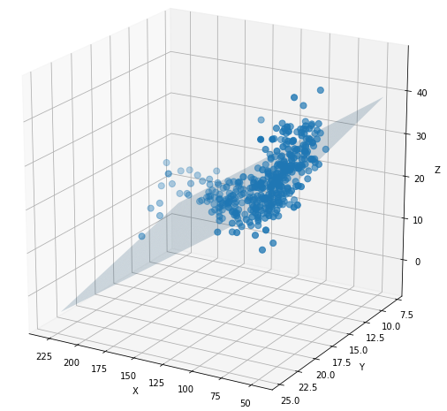
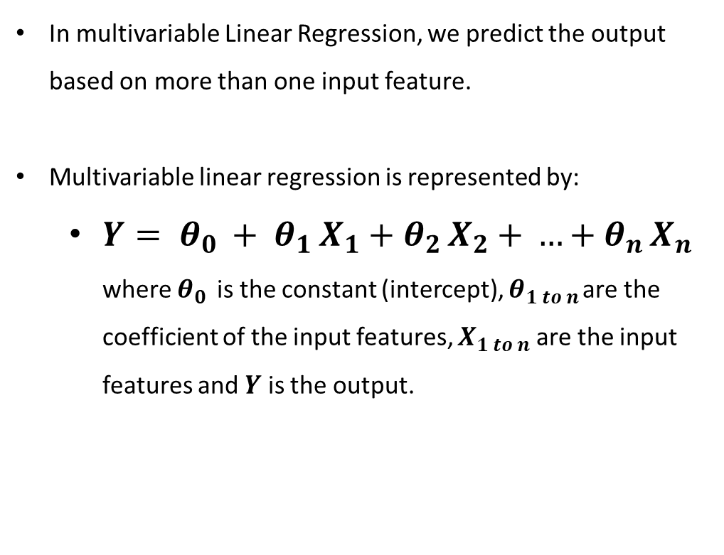
Predictive Models Multivariable Linear Regression
In multivariable Linear Regression, we predict the output based on more than one input feature.
Multivariable linear regression is represented by:
$Y= θ_{0 }+ θ_{1 }X_{1}$ $+ θ_{2 }X_{2}$ $+ …+θ_{n }X_{n}$ where $θ_{0 }$ is the constant (intercept), $θ_{1 to n }$are the coefficient of the input features, $X_{1 to n}$ are the input features and $Y$ is the output.

Slide 20
Predictive Models Multivariable Linear Regression
Open the Jupyter Lab
Now we will implement a multivariable linear regression model to predict the cars’ CO2 emission based on their ‘Engine size’, ‘cylinders’, ‘fuel consumption in city’, ’fuel consumption in highway’, ‘fuel consumption combined’, ’fuel consumption combined mpg’
Import the necessary libraries
Read the “FuelConsumptionCo2.CSV” file. It is uploaded in the model.
Features we want to work on:
import pandas as pd
import numpy as np
import matplotlib.pyplot as plt
from sklearn import linear_model
data = pd.read_csv('FuelConsumptionCo2.csv')
data.head()
X = data[[ 'ENGINESIZE', 'CYLINDERS', 'FUELCONSUMPTION_CITY','FUELCONSUMPTION_HWY',
'FUELCONSUMPTION_COMB','FUELCONSUMPTION_COMB_MPG']]
Y = data["CO2EMISSIONS"]

Slide 21
Predictive Models Multivariable Linear Regression
Splitting the data into training and testing sets:
Training the multivariable linear regression model:
Printing the coefficients:
msk = np.random.rand(len(data)) < 0.8
train = data[msk]
test = data[~msk]
regr = linear_model.LinearRegression()
train_x = np.array(train[[ 'ENGINESIZE', 'CYLINDERS', 'FUELCONSUMPTION_CITY',
'FUELCONSUMPTION_HWY', 'FUELCONSUMPTION_COMB','FUELCONSUMPTION_COMB_MPG']])
train_y = np.array(train["CO2EMISSIONS"])
regr.fit(train_x,train_y)
test_x = np.array(test[[ 'ENGINESIZE', 'CYLINDERS', 'FUELCONSUMPTION_CITY',
'FUELCONSUMPTION_HWY', 'FUELCONSUMPTION_COMB','FUELCONSUMPTION_COMB_MPG']])
test_y = np.array(test["CO2EMISSIONS"])
coeff_data = pd.DataFrame(regr.coef_ , X.columns , columns=["Coefficients"])
coeff_data

Slide 22
Predictive Models Multivariable Linear Regression
Prediction of the test data:
accuracy:
prediction = regr.predict(test_x)
from sklearn.metrics import r2_score
R = r2_score(test_y , prediction)
print ("R² :",R)

Slide 23
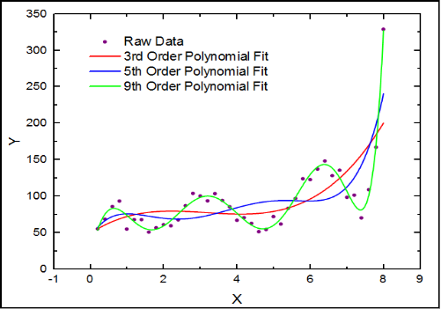
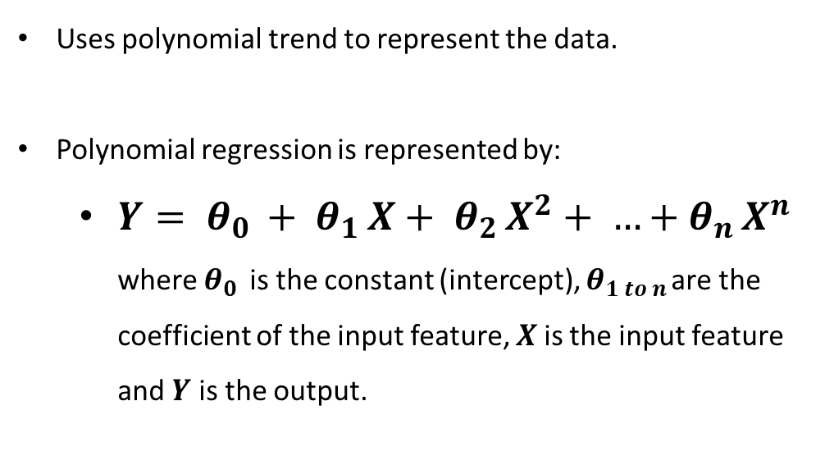
Predictive Models Polynomial Regression
Uses polynomial trend to represent the data.
Polynomial regression is represented by:
$Y= θ_{0 }+ θ_{1 }X+ θ_{2 }X^{2}+ …+θ_{n }X^{n}$ where $θ_{0 }$ is the constant (intercept), $θ_{1 to n }$are the coefficient of the input feature, $X$is the input feature and $Y$ is the output.

Slide 24
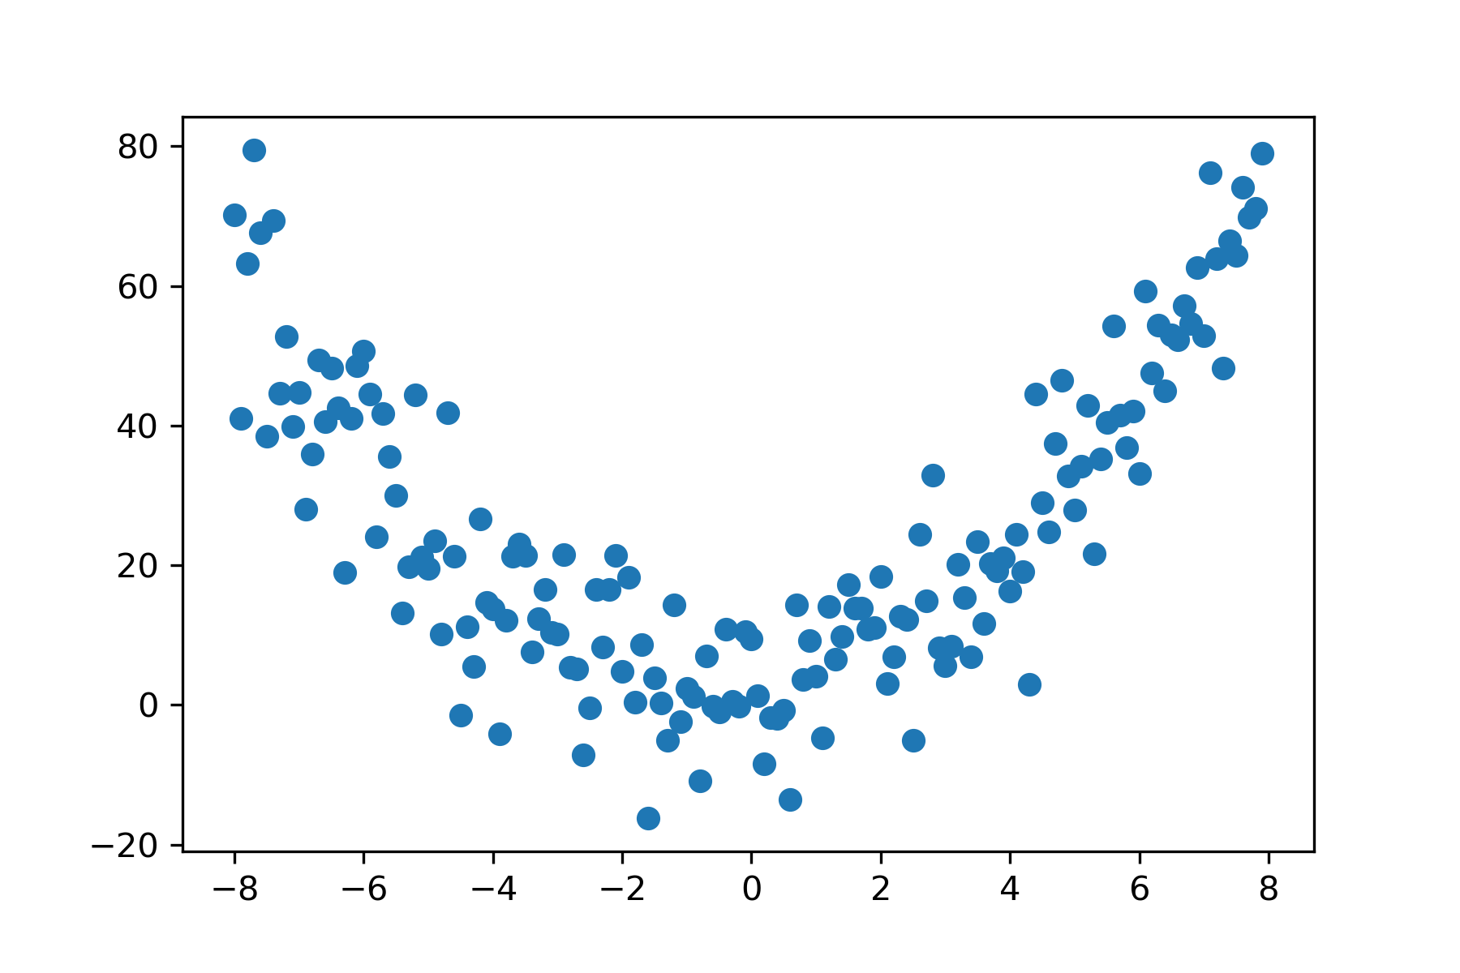
Predictive Models Polynomial Regression
Let’s do a Lab exercise to implement a polynomial regression model in python.
We will generate some random datapoints and the train the polynomial model with them.
Random datapoints generator:
import pandas as pd
import numpy as np
import matplotlib.pyplot as plt
from sklearn import linear_model
from sklearn import preprocessing
from sklearn import metrics
x = np.arange(-8,8,0.1)
rand = 10 * np.random.normal(size = len(x))
y = 1*(x**2) + 1*x + 5+rand
plt.scatter(x,y)

Slide 25
Predictive Models Polynomial Regression
Combine the points into a dataframe:
Splitting the data into training and testing sets:
Extracting the train_x and train_y from the training set
Extracting the test_x and test_y from the testing set
d = {'x':x,'y':y}
data = pd.DataFrame(d)
msk = np.random.rand(len(data)) < 0.8
train = data[msk]
test = data[~msk]
train_x = np.array(train[['x']])
train_y = np.array(train[['y']])
test_x = np.array(test[['x']])
test_y = np.array(test[['y']])

Slide 26
Predictive Models Polynomial Regression
Specifying the degree of the polynomial equation
Transforming the train_x to fit the polynomial feature
Define and train the model
nb_degree = 2
polynomial_features = preprocessing.PolynomialFeatures(degree = nb_degree)
train_x_transformed = polynomial_features.fit_transform(train_x.reshape(-1,1))
model = linear_model.LinearRegression()
model.fit(train_x_transformed, train_y)

Slide 27
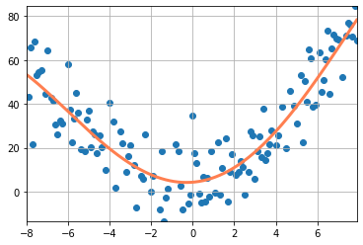
Predictive Models Polynomial Regression
Predicting the model:
Calculating RMSE and R2 Score
Plotting the best fit line:
test_x_transformed = polynomial_features.fit_transform(test_x.reshape(-1,1))
prediction = model.predict(test_x_transformed)
rmse = np.sqrt(metrics.mean_squared_error(test_y,prediction))
r2 = metrics.r2_score(test_y, prediction)
print('RMSE: ', rmse)
print('R2: ', r2)
x_transformed = polynomial_features.fit_transform(x.reshape(-1,1))
prediction_train = model.predict(x_transformed)
x_min = np.amin(x)
x_max = np.amax(x)
y_min = np.amin(y)
y_max = np.amax(y)
x_new = np.linspace(x_min, x_max, len(x_transformed))
x_new = x_new[:,np.newaxis]
plt.plot(x_new, prediction_train, color='coral', linewidth=3)
plt.grid()
plt.xlim(x_min,x_max)
plt.ylim(y_min,y_max)
plt.scatter(train_x,train_y)

Slide 28
Any Questions?

